Slide 1




INFO5100 Final Project
Orphan Sweet Home
Yanqi Ma: 002774114
Zihao Liu：001567668
Wentian Zhang: 002738592

Slide 2
Contents/
Entities
02
The content of enterprises and organizations
04
Project Background
Problems we are facing and out solutions
Advanced features
Models
Use Case
01
Show models and diagrams
03
Display use case
05

Slide 3
01
PROJECT BACKGROUND
Problems we are facing and out solutions

Slide 4
Problems
The increasing number of orphans due to COVID-19 deaths is leading to social instability.
Johns Hopkins University reports that the US has nearly one million cumulative deaths, leaving many children without parents or primary caregivers. Imperial College data from April 2022 shows that around 197,000 US minors have lost at least one parent to COVID-19, while 250,000 have lost their primary or secondary guardians.
Therefore, it is important to create a system of sweet home for orphans to help them get out of the physical and mental gloom and find warm families to adopt.

Slide 5
We combine these problems together and provide a system that makes the process of adopting orphans easy and convenient with Java Swing
The purpose of our system to make sure the orphan is healthy and verify the adopter is qualified before accessing the orphan's information at the same time. We also provide the opportunity to volunteer and the volunteers could process their work independently.
Solutions
We consider the use case from medical checkers, volunteers, and adopters. At the same time, with the use case of system admin, this system is expandable at the global level.
Every orphan is responsible by a single manager, the manager is permitted to have an overview of an orphan.

Slide 6
02
MODELS
Show models and diagrams

Slide 7
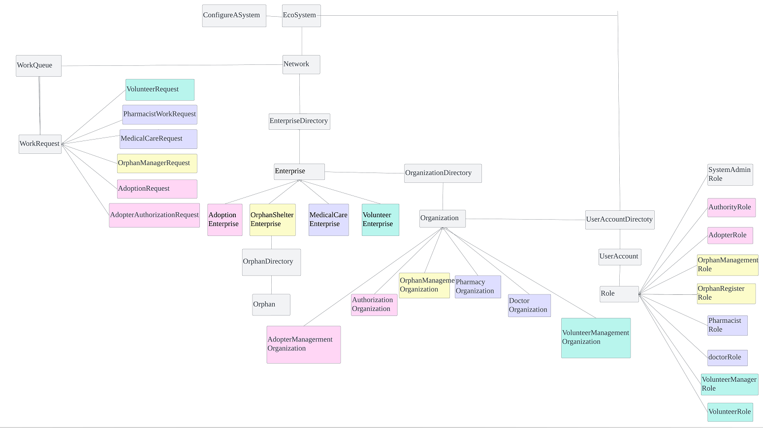
High-level Component Model

Slide 8
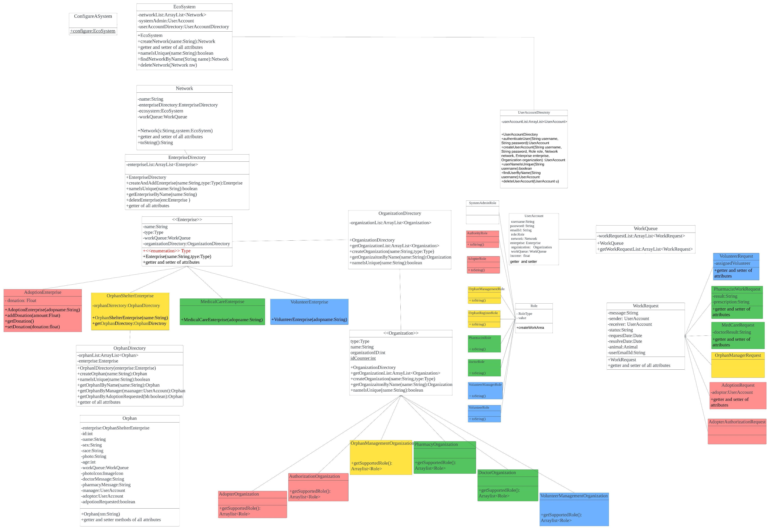
UML MODEL

Slide 9
03
ENTITIES
The program structure

Slide 10
System Admin Role
Enterprise Admin Role
Manage Network
Manage Enterprise
Manage Organizations
Manage Adopter Users
Manage Default Users
View Dashboard
Manage Organizations

Slide 11


ENTERPRISE
Enterprises
ORPHAN SHELTER
第三季度
MEDICAL CARE
ADOPTION
VOLUNTEER

Slide 12
Orphan Shelter Enterprise
Orphan Management Organization
Orphan Register Role
Orphan Management Role
Register Orphan
Request volunteers
Orphan Assignment
View Orphan Details:
- Send Medical care request
View Adoption Request

Slide 13
Medical Care Enterprise
Doctor Organization
Pharmacy Organization
Doctor Role
Pharmacist Role
Receive Doctor Request
View Orphan Details
- Request Pharmaceutical Therapy
- Submit Doctor Result
Receive Pharmaceutical Therapy Request
Submit Pharmaceutical Result

Slide 14
Adoption Enterprise
Adopter Management Organization
Authorization Organization
Adopter Role
Authority Role
Donate Adoption Shelter
View Orphan Detail
Request Adoption
Review the eligibility of adopter

Slide 15
Volunteer Enterprise
Volunteer Management Organization
Volunteer Manager Role
Volunteer Role
Receive volunteer request from Orphan Register
Assign volunteer
View Help Request
Mark request as complete

Slide 16
04
USE CASE
Display use case

Slide 17
05
Advanced Features

Slide 18
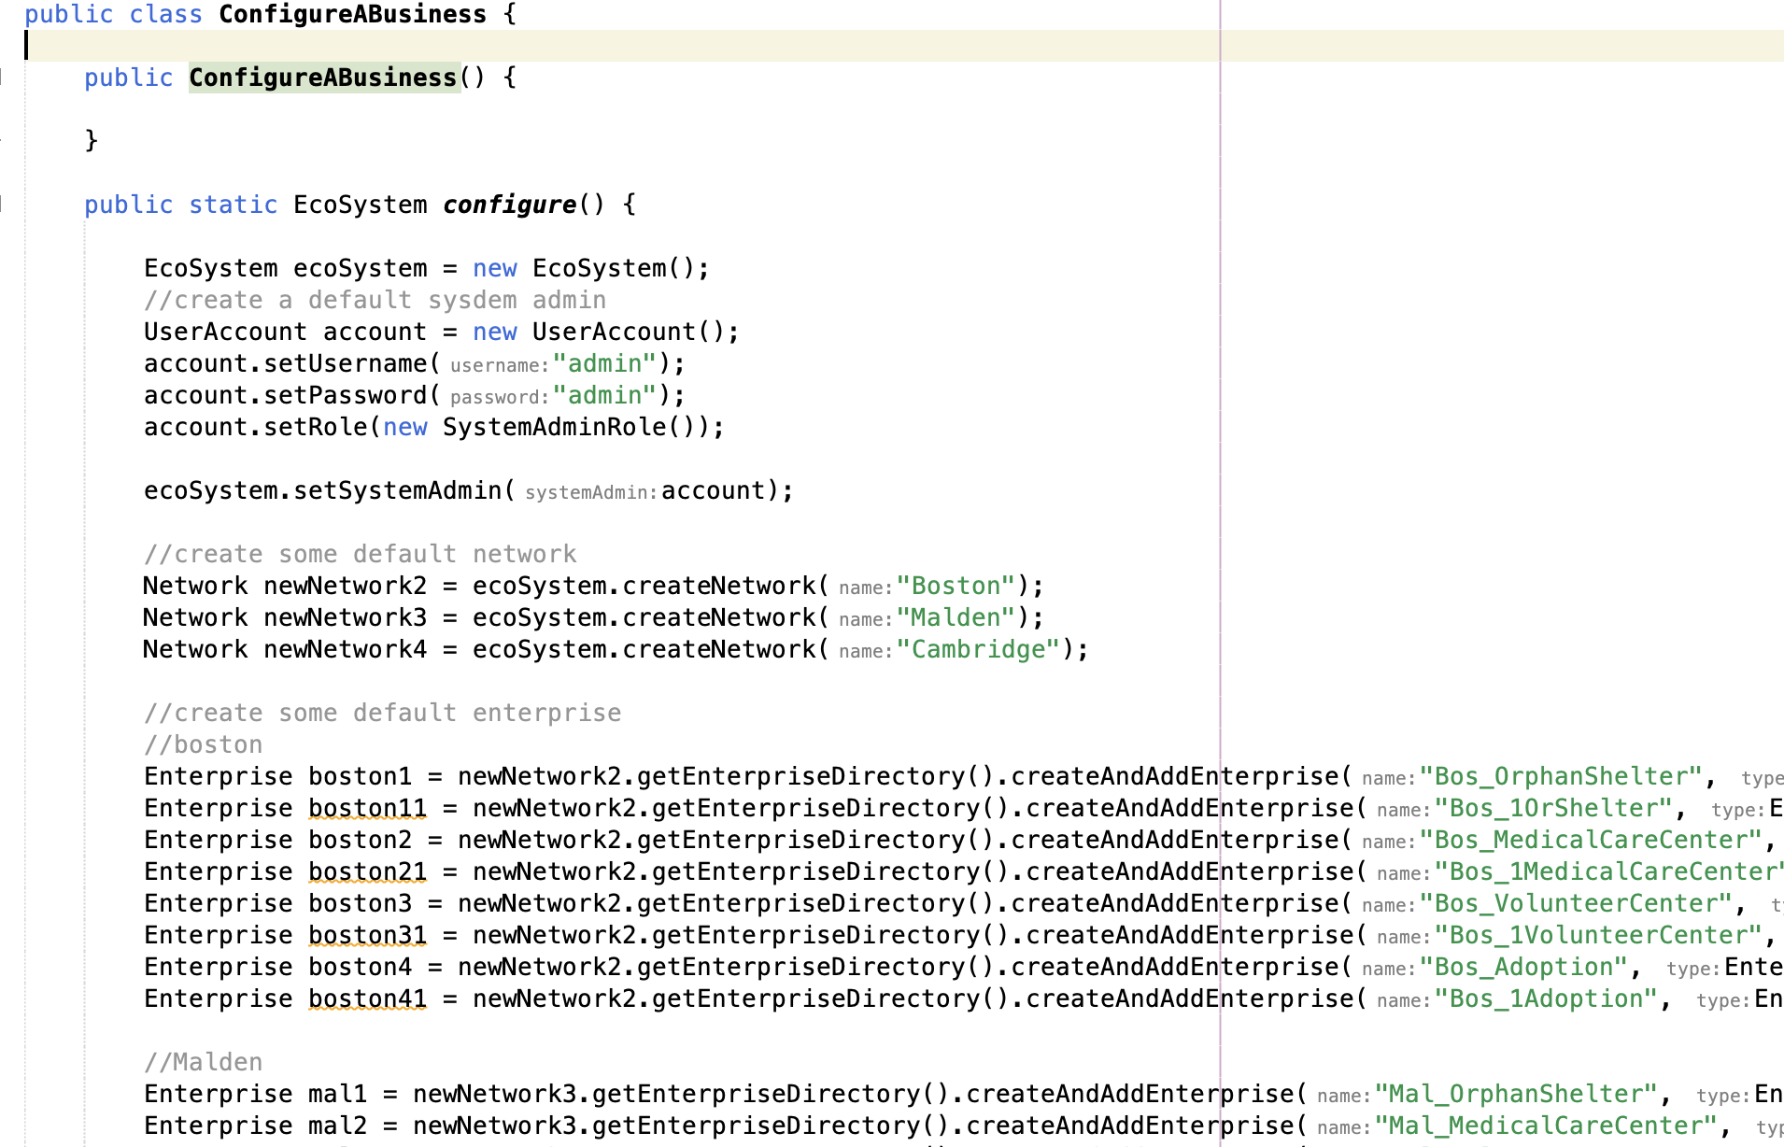
Initialize Data

Slide 19

KGradientPanel

Slide 20
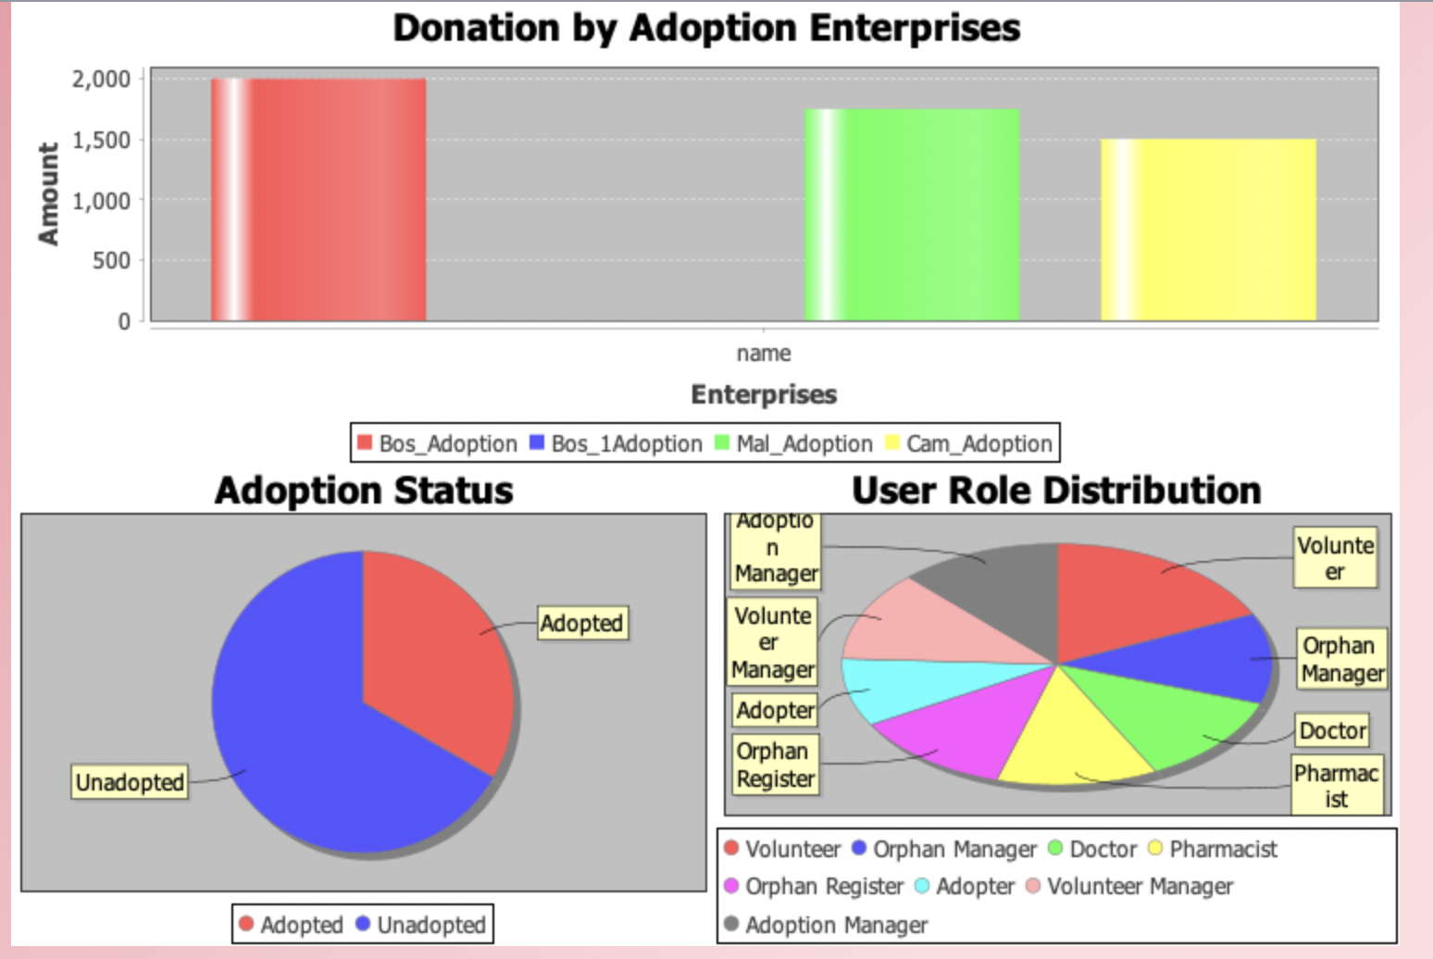
JFreeChart

Slide 21
INFO5100 FINAL PROJECT
Thank you for watching
Yanqi Ma: 002774114
Zihao Liu：001567668
Wentian Zhang: 002738592

